Slide 1
Systems Analysis
Systems I– 420-E11

Slide 2
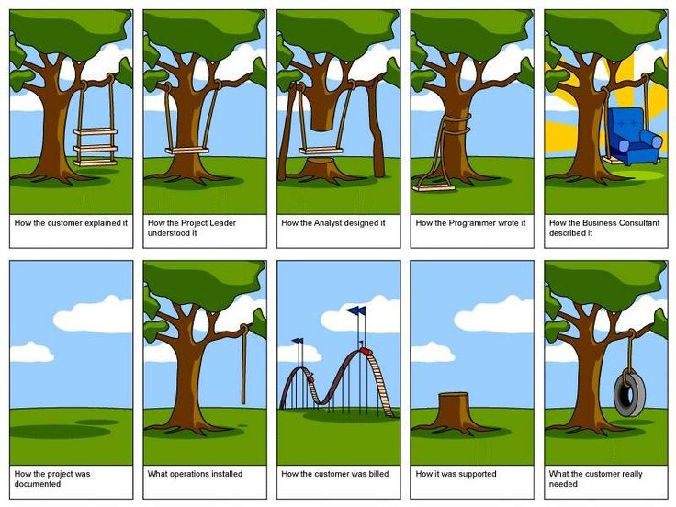
https://www.reddit.com/r/AskReddit/comments/1kvhmz/whats_the_best_programming_joke_that_you_know/
Notes:
From this picture, you can see how the key to proper systems analysis it to effectively gather and understand your client’s requirements
How did we get from a swing to a tire?

Slide 3
Why Systems Analysis?
Only 1 out of 3 software projects complete on-time and on-budget (The Standish Group report, 2015)
90% of developers have missed production dates within the past year
Missing deadlines is routine for 67% of projects
91% have removed key functionality late in the development cycle to meet deadlines
Notes:
https://www.standishgroup.com/sample_research_files/BigBangBoom.pdf

Slide 4
IT Project Success Rates

Slide 5
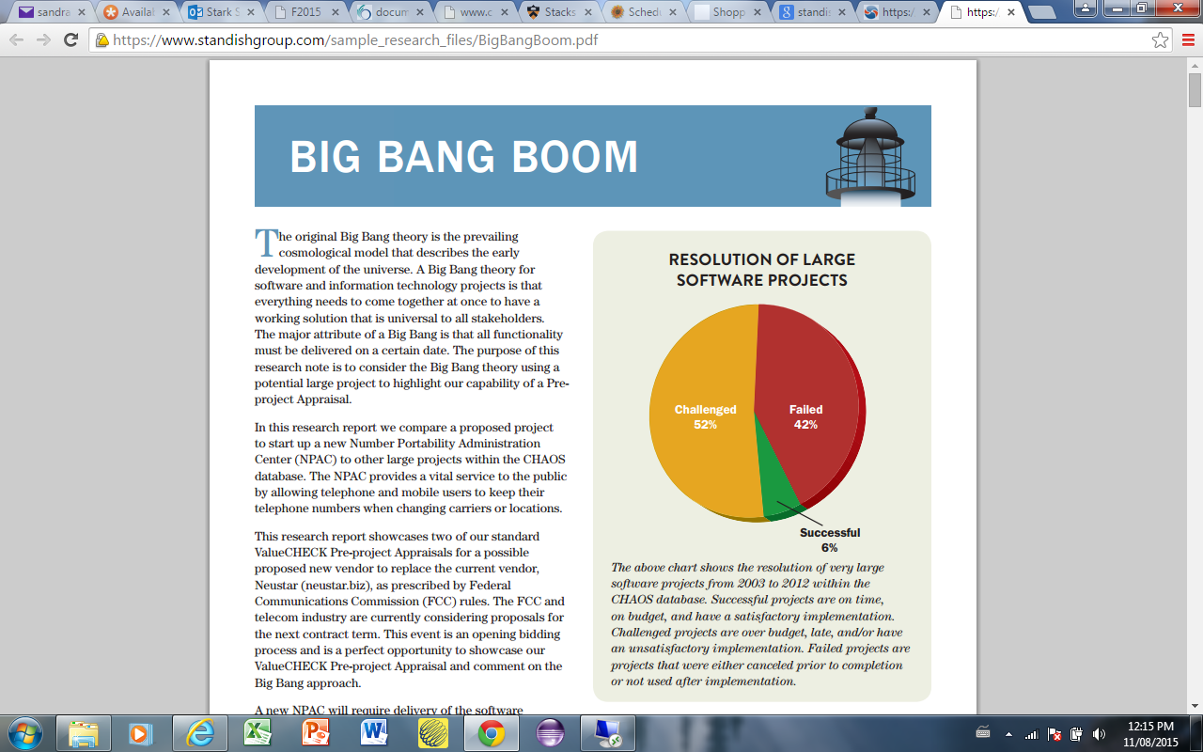
Notes:
https://www.standishgroup.com/sample_research_files/BigBangBoom.pdf

Slide 6
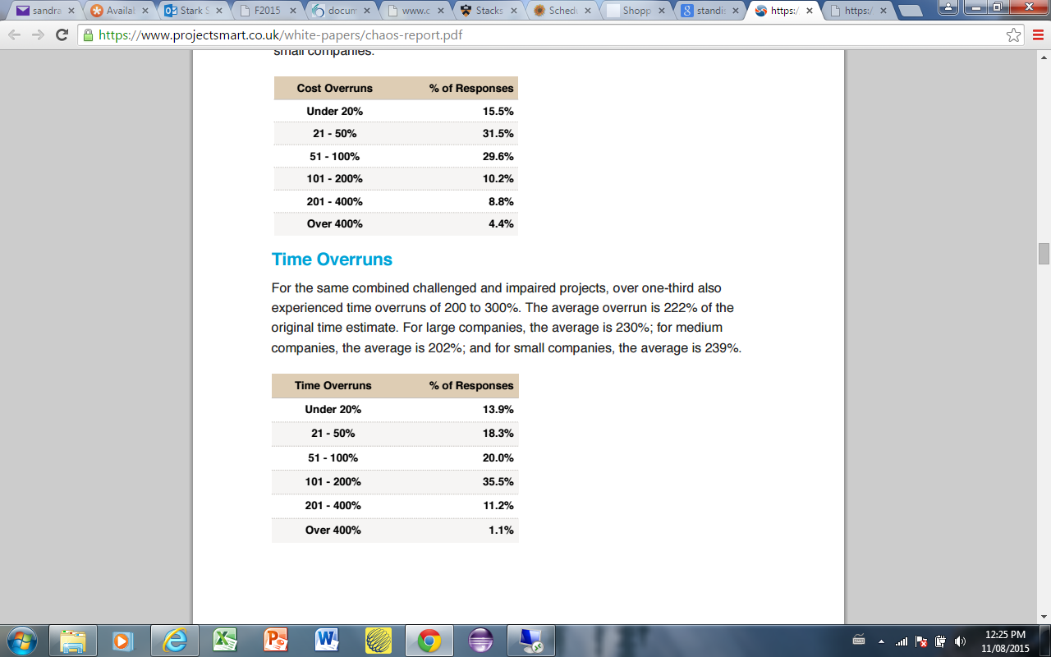
Cost Overruns
Notes:
https://www.projectsmart.co.uk/white-papers/chaos-report.pdf

Slide 7
Time Overruns
Notes:
www.projectsmart.co.uk/white-papers/chaos-report.pdf

Slide 8
Causes of Problems
Lack of methodology/standard
Poor communication
Complexity of systems
Unreasonable expectations about the development process
Lack of quality metrics and quality processes
Poor or no documentation
Notes:
Documentation not as big an issue we are finding – Agile has started to change that idea

Slide 9
Other Issues
Software is inherently complex
Interdependencies between components
Data intensive applications are particularly complex
Software must conform to:
Hardware/software platform on which it is built
Pre-existing information systems

Slide 10
Other Issues
Software must be built to accommodate change
Software is buried deeply in “invisible” programming statements, binary library code, and surrounding system software
Too many variants
“Not Invented Here” Syndrome
Notes:
What are some of the variants? – user base, management, functionality, platform, acquisition/procurement, scope change, quality, software used

Slide 11
Real Life Example
A real-estate group in the federal government cosponsored a data warehouse with the IT department.
In the formal proposal, written by IT, costs were estimated at $800,000, the project duration was estimated to be eight months, and the responsibility for funding was defined as the business units.
The IT department proceeded before it knew if the project had been accepted.

Slide 12
Real Life Example…(cont’d)
The project actually lasted two years because requirements gathering took nine months instead of one and a half, the planned user base grew from 200 to 2,500, and the approval process to buy the technology for the project took a year.
Three weeks prior to delivery, the IT director cancelled the project. The failure cost the organization $2.5 million.

Slide 13
Real life example questions
1. Why did the system fail?
2. Why would the company spend so much time and money on a project and then cancel it?
3. What could have been done to prevent this?

Slide 14
Goal of a System
The Primary Goal of a System is to create value for the organization.

Slide 15
What is a System?
A collection of interrelated components that function together to achieve some outcome.
Information systems have 5 key components
People
Processes
Hardware
Software
Data

Slide 16
Systems you are familiar with
Course Management System – Moodle
College Management System – Omnivox
Online System for Purchasing Movie Tickets
Payroll System

Slide 17
Characteristics of a System
A level of complexity
Distinctive components arranged according to some plan or structure
Components have describable relationships to other components
May have subsystems, may be part of a larger system
Has a definite purpose or function
Has a definite boundary but does not exist in isolation

Slide 18
Analysis
The resolution of anything complex into its simple elements; the exact determination of its components.

Slide 19
Methodology
A process model composed of tasks, work products and roles for consistently and cost-effectively achieving specified objectives.
Communicated to and understood by all participants
Measurable and predictable

Slide 20
Life Cycle / Methodology
The project
Moves systematically through phases where each phase has a standard set of outputs
Produces project deliverables
Uses deliverables in implementation
Results in actual information system
Uses gradual refinement

Slide 21
Project Sections
Planning
Why build the system?
Analysis
Who, what, when, where will the system be?
Design
How will the system work?
Implementation
System delivery
Planning
Analysis
Design
Implementation

Slide 22
Planning
Identifying business value
Analyze feasibility
Develop work plan
Staff the project
Control and direct project

Slide 23
Analysis
Analysis
Information gathering
Process modeling
Data modeling

Slide 24
Design
Physical design
Architectural design
Interface design
Database and file design
Program design

Slide 25
Implementation
Construction
Installation

Slide 26
Operations (Post-Implementation)
On going maintenance
Hardware maintenance
System software maintenance
Bug fixes
Enhancements
Day-to-day functioning

